Slide 1
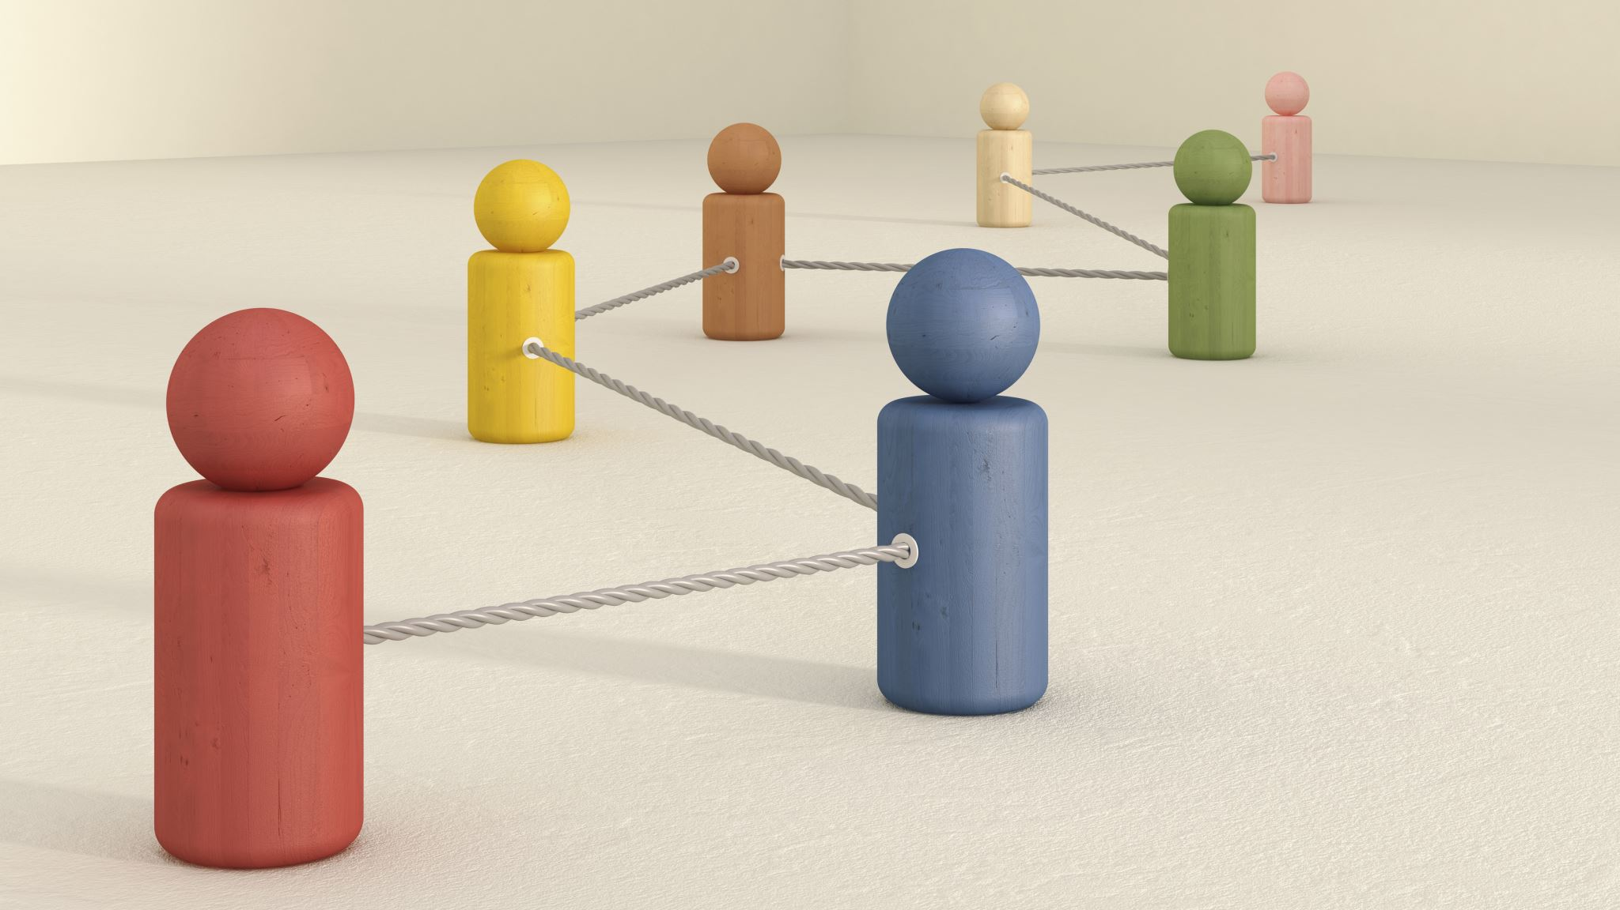
Encoder Decoder model (Sequence to Sequence Model)

Slide 2
Rethink about RNN
Encoder: present a piece of text as a vector
Decoder: decode the presentation into outputs
Dense
Decoder
}
LSTM
Encoder
Embedding
this
movie
is
great
Slide credit: Alex Smola and Mu Li (Berkley)

Slide 3
The Encoder-decoder Architecture
A model is partitioned into two parts
The encoder process inputs
The decoder generates outputs
Encoder
Decoder
Input
State
Output
Input
Slide credit: Alex Smola and Mu Li (Berkley)

Slide 4

Machine Translation
Given a sentence in a source language, translate into a target language
These two sequences may have different lengths

Slide 5
Neural Machine Translation
Neural machine Translation (NMT) – Machine translation with a single neural network
The neural network architecture typically involves two RNNs – this is called sequence-to-sequence

Slide 6
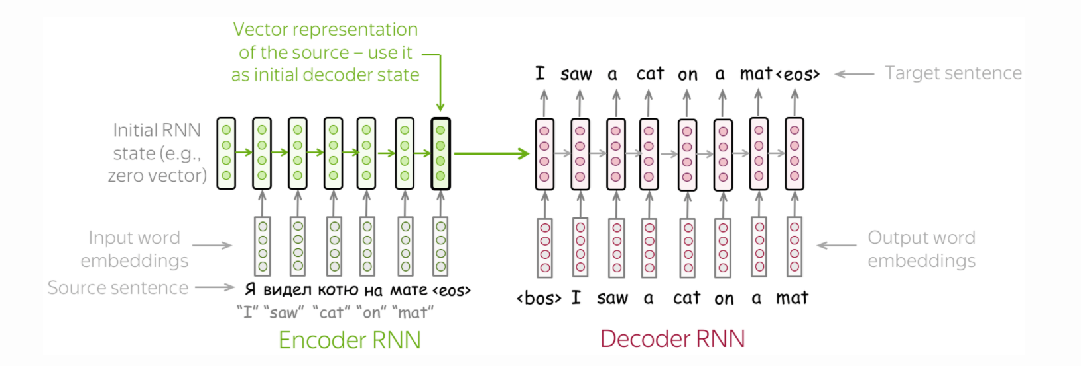
Neural Machine Translation
Encoder RNN produces an encoding of the source sentence
Decoder RNN is a language model that generates target conditional on encoding.
Image source https://lena-voita.github.io/nlp_course/seq2seq_and_attention.html

Slide 7
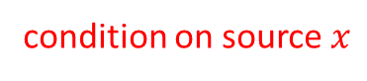
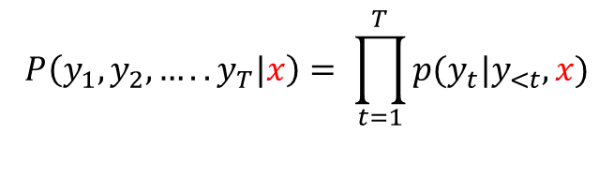
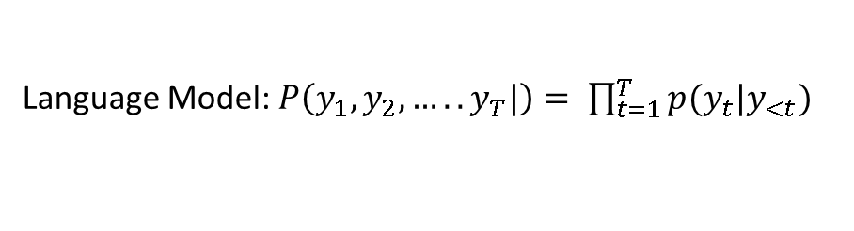
Neural Machine Translation
Language Model: $P\left(y_{1},y_{2},…..y_{T}|\right)= \prod_{t=1}^{T}{p(y_{t}|y_{<t})}$
Conditional Language Models
condition on source $x$
$$P\left(y_{1},y_{2},…..y_{T}|x\right)= \prod_{t=1}^{T}{p(y_{t}|y_{<t},x)}$$
$$=P\left(y_{1} | x\right)P\left(y_{2} | y_{1},x\right)P\left(y_{3} | y_{1},y_{2},y_{3},x\right)………..P(y_{T}|y_{1},…y_{T−1},x)$$
Probability of next target word , given target word so far and source sentence

Slide 8
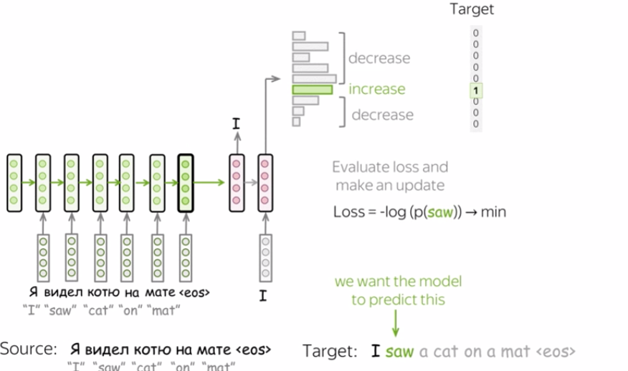
Training Neural Machine Translation
Image source https://lena-voita.github.io/nlp_course/seq2seq_and_attention.html

Slide 9
Encoder/Decoder summary
The encoder is a standard RNN model without the output layer
The encoder’s hidden state in last time step is used as the decoder’s initial hidden state
Encoder
Decoder
Dense
n x
Recurrent layer
Recurrent layer
x n
Embedding
Embedding
Sources
Targets

Slide 10

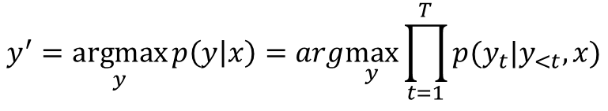
Predictions – Test Data
We model the probability of a sentence as follows:
$$y^{′}=\underset{y}{argmax}{p\left(y | x\right)=arg\max_{y}{\prod_{t=1}^{T}{p(y_{t}|y_{<t},x)}}}$$
We cannot find the exact solution.
WHY ?

Slide 11
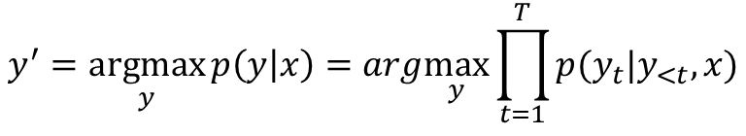
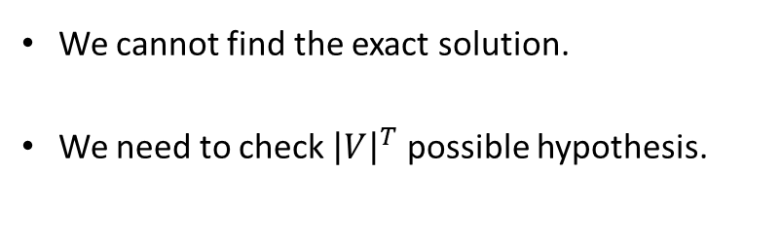
Predictions – Test Data
We model the probability of a sentence as follows:
$$y^{′}=\underset{y}{argmax}{p\left(y | x\right)=arg\max_{y}{\prod_{t=1}^{T}{p(y_{t}|y_{<t},x)}}}$$
We cannot find the exact solution.
We need to check ${\left|V\right|}^{T}$ possible hypothesis.

Slide 12
Predictions – Test Data
For every possible sequence, compute its probability and pick the best one
If output vocabulary size is V, and max sequence length T, then we need to examine V^{T} sequences
It’s computationally infeasible
For Example if, V = 10000, T = 10 , V^{T} = 10⁴⁰

Slide 13
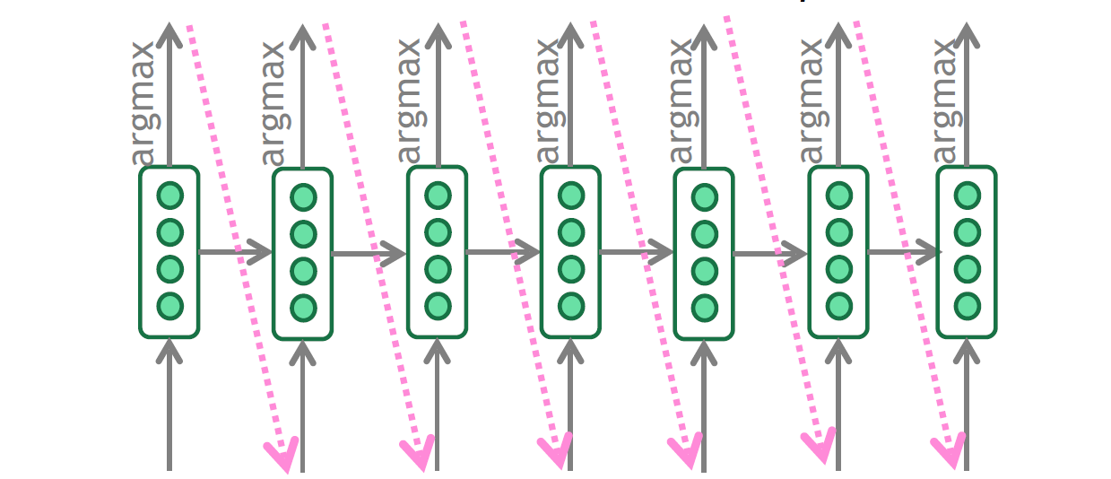
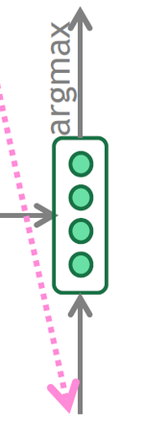

Predictions – Greedy Decoding
a
in
my
<eos>
At each step, pick the most
probable token
I
saw
cat
dream
Problems ?
<bos>
I
saw
a
cat
in
my
dream

Slide 14
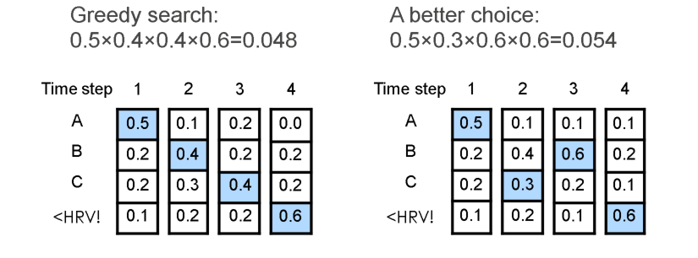
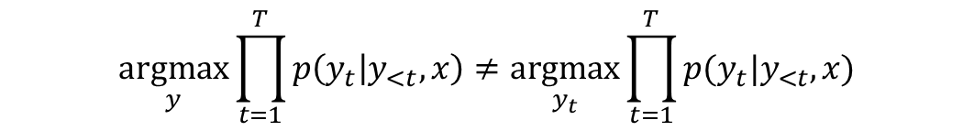
Predictions – Greedy Decoding
Cannot undo incorrect decision
I ____
I saw ___
I saw a ____
I saw a cat___
I saw a cat in __
$$\underset{y}{argmax}{\prod_{t=1}^{T}{p\left(y_{t} | y_{<t},x\right)}}≠\underset{y_{t}}{argmax}{\prod_{t=1}^{T}{p(y_{t}|y_{<t},x)}}$$

Slide 15

Beam Search

Slide 16
Beam search decoding
Core idea: On each step of decoder, keep track of the k most probable partial translations (which we call hypotheses)
k is the beam size (in practice around 5 to 10)
A hypothesis has a score which is its log probability.
Scores are all negative, and higher score is better
We search for high-scoring hypotheses, tracking top k on each step
Beam search is not guaranteed to find optimal solution
But much more efficient than exhaustive search!

Slide 17
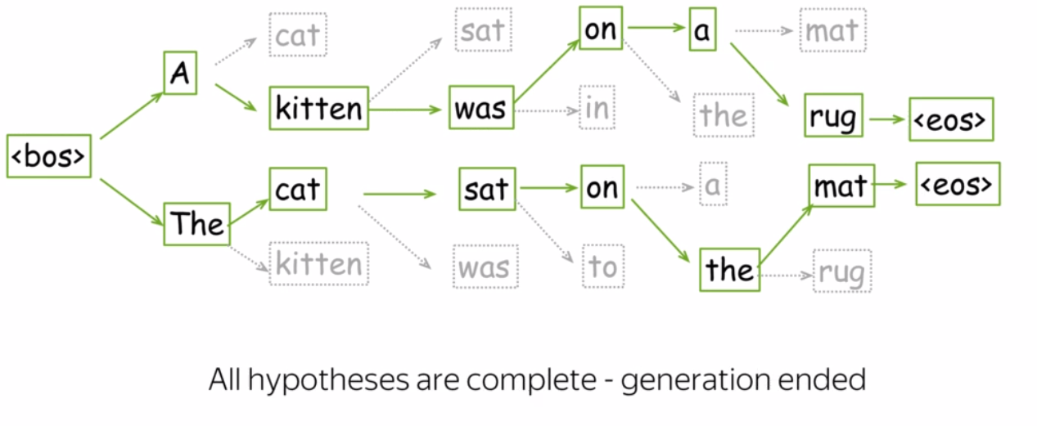
Beam Search
Image source https://lena-voita.github.io/nlp_course/seq2seq_and_attention.html

Slide 18
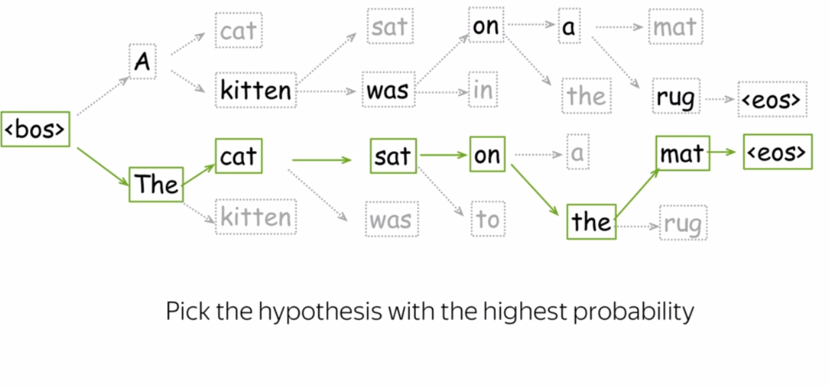
Beam Search
Image source https://lena-voita.github.io/nlp_course/seq2seq_and_attention.html

Slide 19
Beam search decoding: stopping criterion
In beam search decoding, different hypotheses may produce <END> tokens on different timesteps
When a hypothesis produces <END>, that hypothesis is complete.
Place it aside and continue exploring other hypotheses via beam search.
Usually we continue beam search until:
We reach timestep T (where T is some pre-defined cutoff), or
We have at least n completed hypotheses (where n is pre-defined cutoff)
Slide Source : http://web.stanford.edu/class/cs224n/slides/cs224n-2020-lecture08-nmt.pdf

Slide 20
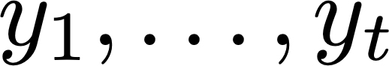
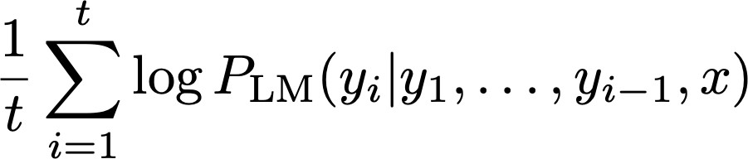
Beam search decoding: finishing up
We have our list of completed hypotheses.
How to select top one with highest score?
Each hypothesis on our list has a score
Problem with this: longer hypotheses have lower scores
Fix: Normalize by length. Use this to select top one instead:
Slide Source : http://web.stanford.edu/class/cs224n/slides/cs224n-2020-lecture08-nmt.pdf

Slide 21
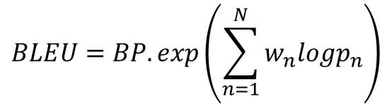
Evaluation
BLEU (Papineni et al. 2002): what fraction of {1-4}-grams in the system translation appear in the reference translations?
$$p_{n}=\frac{Number of ngrams in system and refernce translations}{Number of ngrams in system translation}$$
$$BLEU=BP.exp\left(\sum_{n=1}^{N}{w_{n}logp_{n}}\right)$$
https://www.youtube.com/watch?v=DejHQYAGb7Q

Slide 22
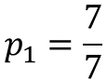
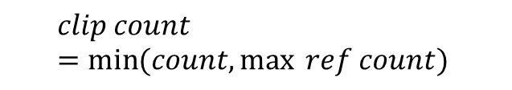
Evaluation
French: Le chat est sur le tapis.
Reference 1: The cat is on the mat.
Reference 2: There is a cat on the mat.
MT output: the the the the the the the.
Precision:
Modified precision:
$$clip count=\min{(count,\max{ ref count)} }$$
$$p_{1}=\frac{7}{7}$$
$$\frac{2}{7}$$

Slide 23
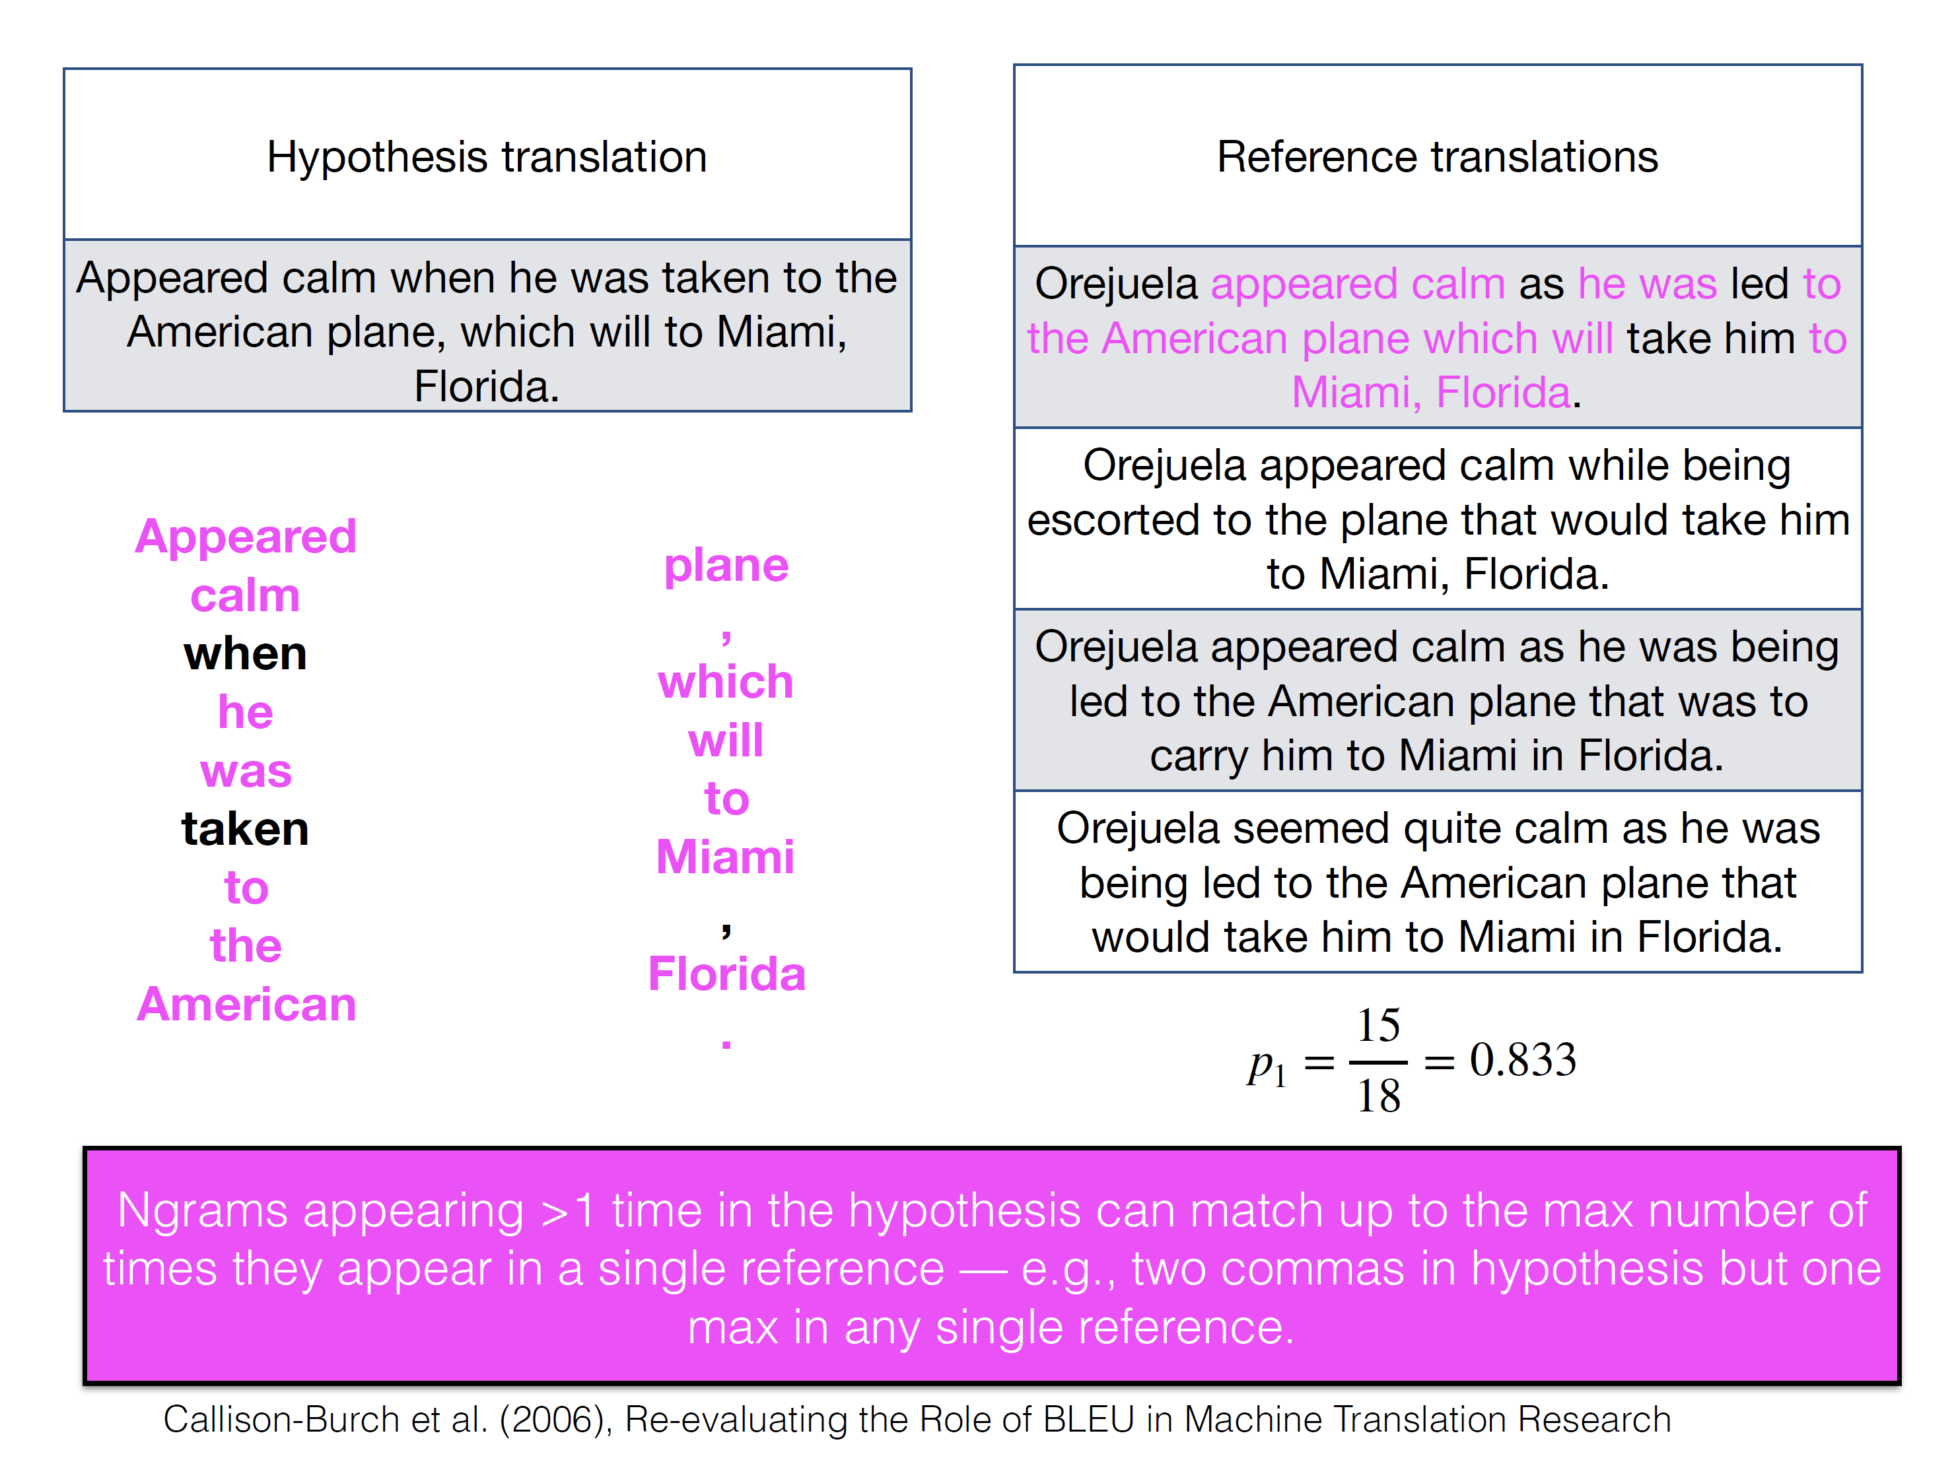
Evaluation
Slide Credit: David Bamman (UC Berkley)

Slide 24
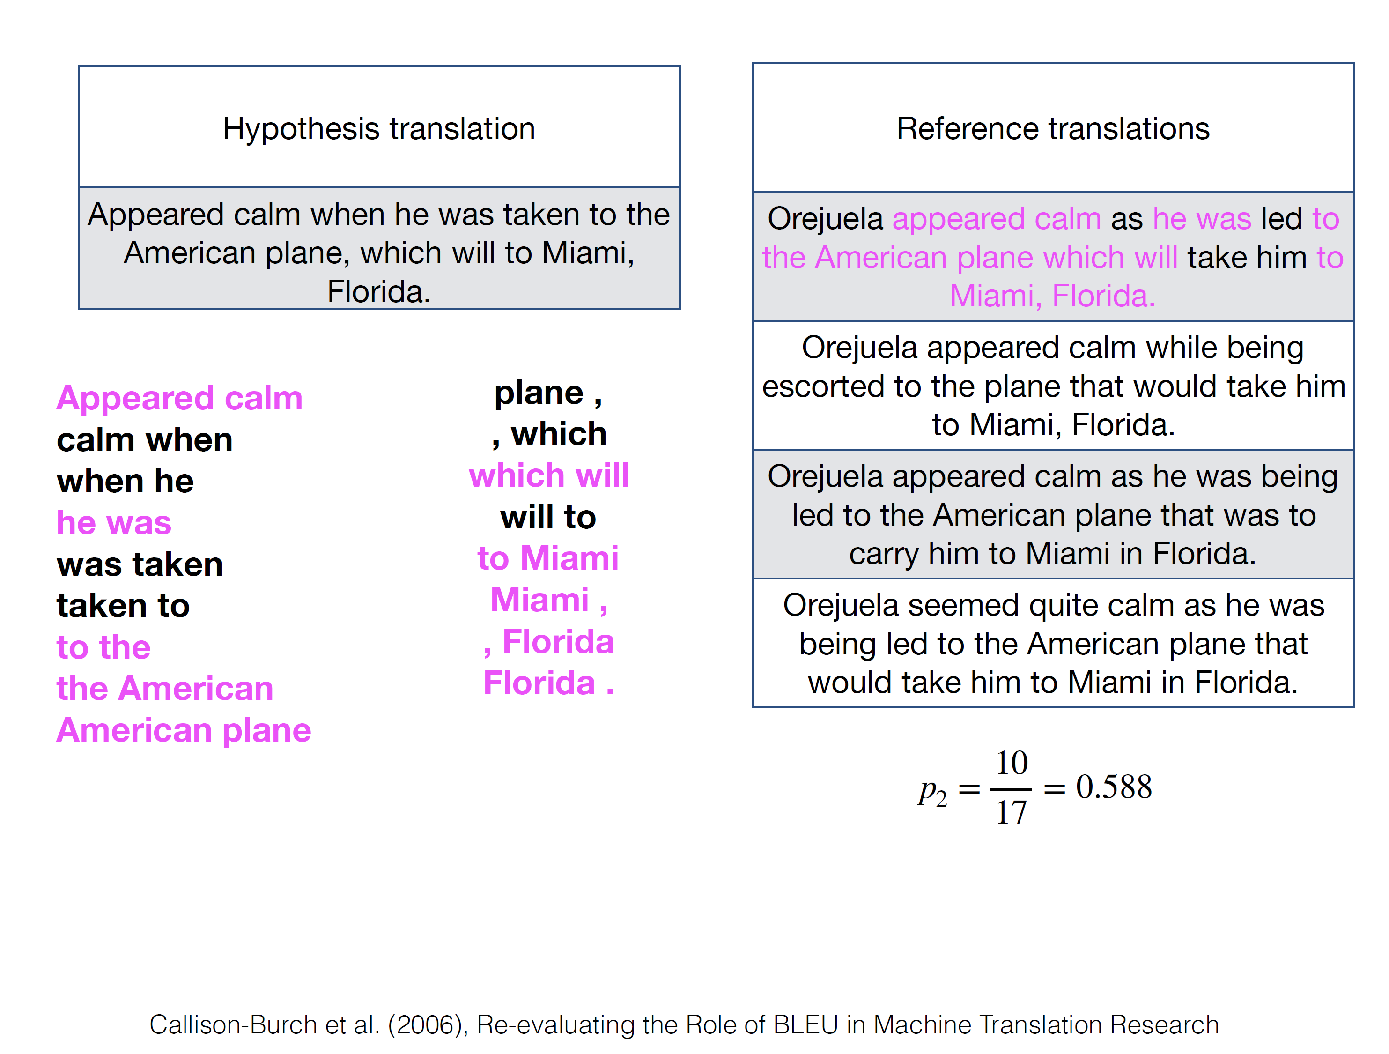
Evaluation
Slide Credit: David Bamman (UC Berkley)

Slide 25
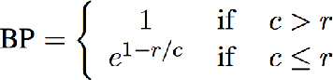
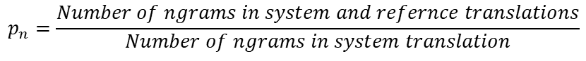
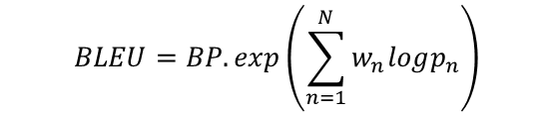
Evaluation
We could optimize the score by minimizing the denominator (the number of ngrams generated)
$$p_{n}=\frac{Number of ngrams in system and refernce translations}{Number of ngrams in system translation}$$
$$BLEU=BP.exp\left(\sum_{n=1}^{N}{w_{n}logp_{n}}\right)$$
c = length of hypothesis translation
r = length of closest reference translation

Slide 26

ATTENTION

Slide 27


Attention
Attention provides a solution to the bottleneck problem.
Core idea: on each step of the decoder, use direct connection to the encoder to focus on a particular part of the source sequence

Slide 28
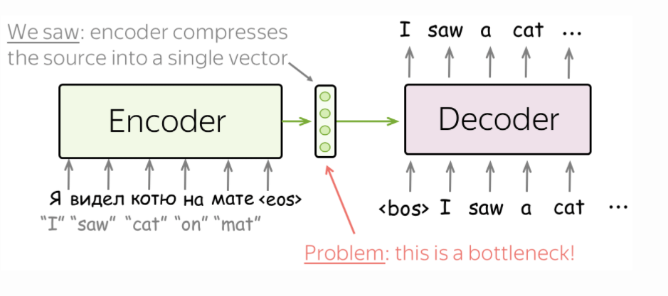
sequence-to-sequence – bottleneck problem
Problem with architecture ?
Image source https://lena-voita.github.io/nlp_course/seq2seq_and_attention.html

Slide 29
sequence-to-sequence – bottleneck problem
Fixed source representation is suboptimal:
for the encoder, it is hard to compress the sentence
for the decoder, different information may be relevant at different steps
Image source https://lena-voita.github.io/nlp_course/seq2seq_and_attention.html

Slide 30
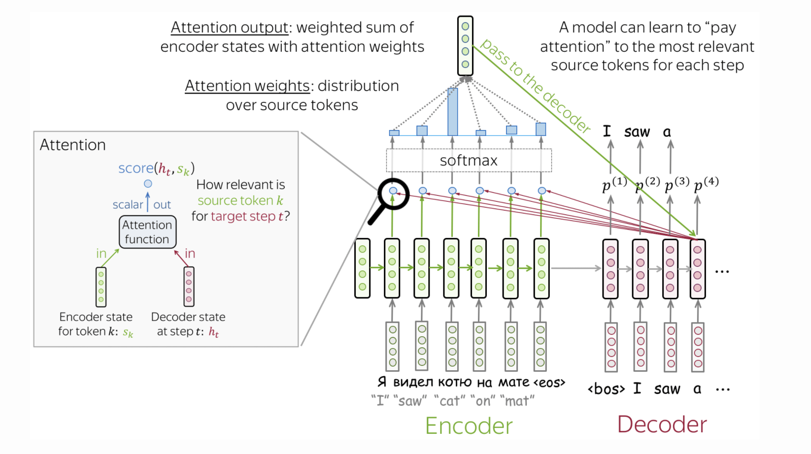
Attention
Image source https://lena-voita.github.io/nlp_course/seq2seq_and_attention.html

Slide 31
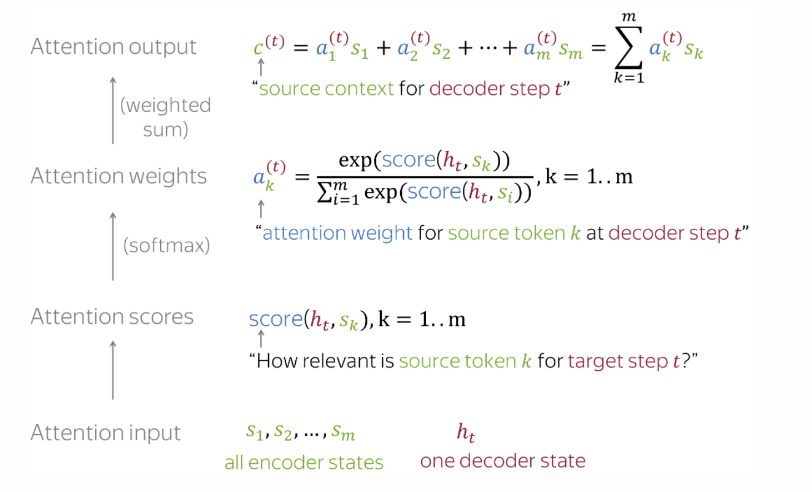
Attention Layer
Image source https://lena-voita.github.io/nlp_course/seq2seq_and_attention.html

Slide 32
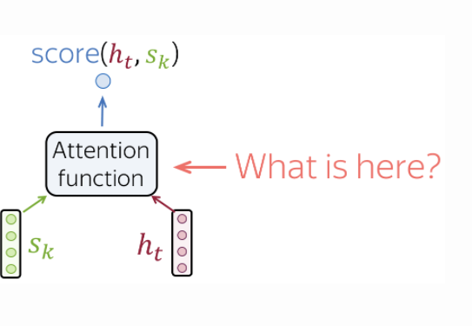
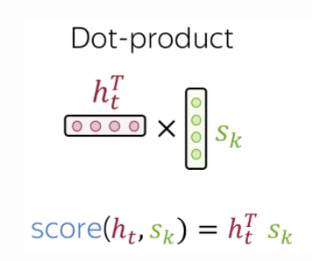
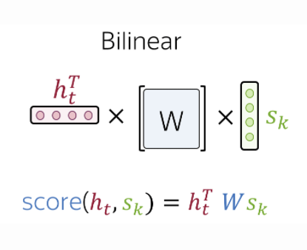
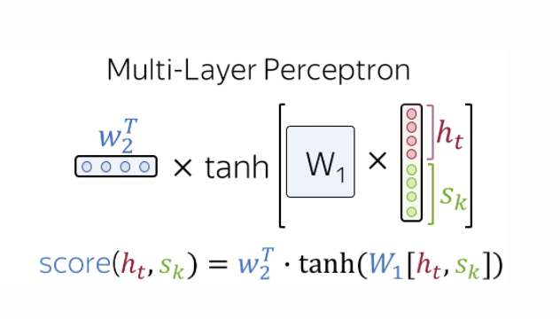
Ways to Calculate Attention scores
dot-product - the simplest method
bilinear function (aka "Luong attention") - used in the paper Effective Approaches to Attention-based Neural Machine Translation
multi-layer perceptron (aka "Bahdanau attention") - the method proposed in the original paper.
Image source https://lena-voita.github.io/nlp_course/seq2seq_and_attention.html

Slide 33
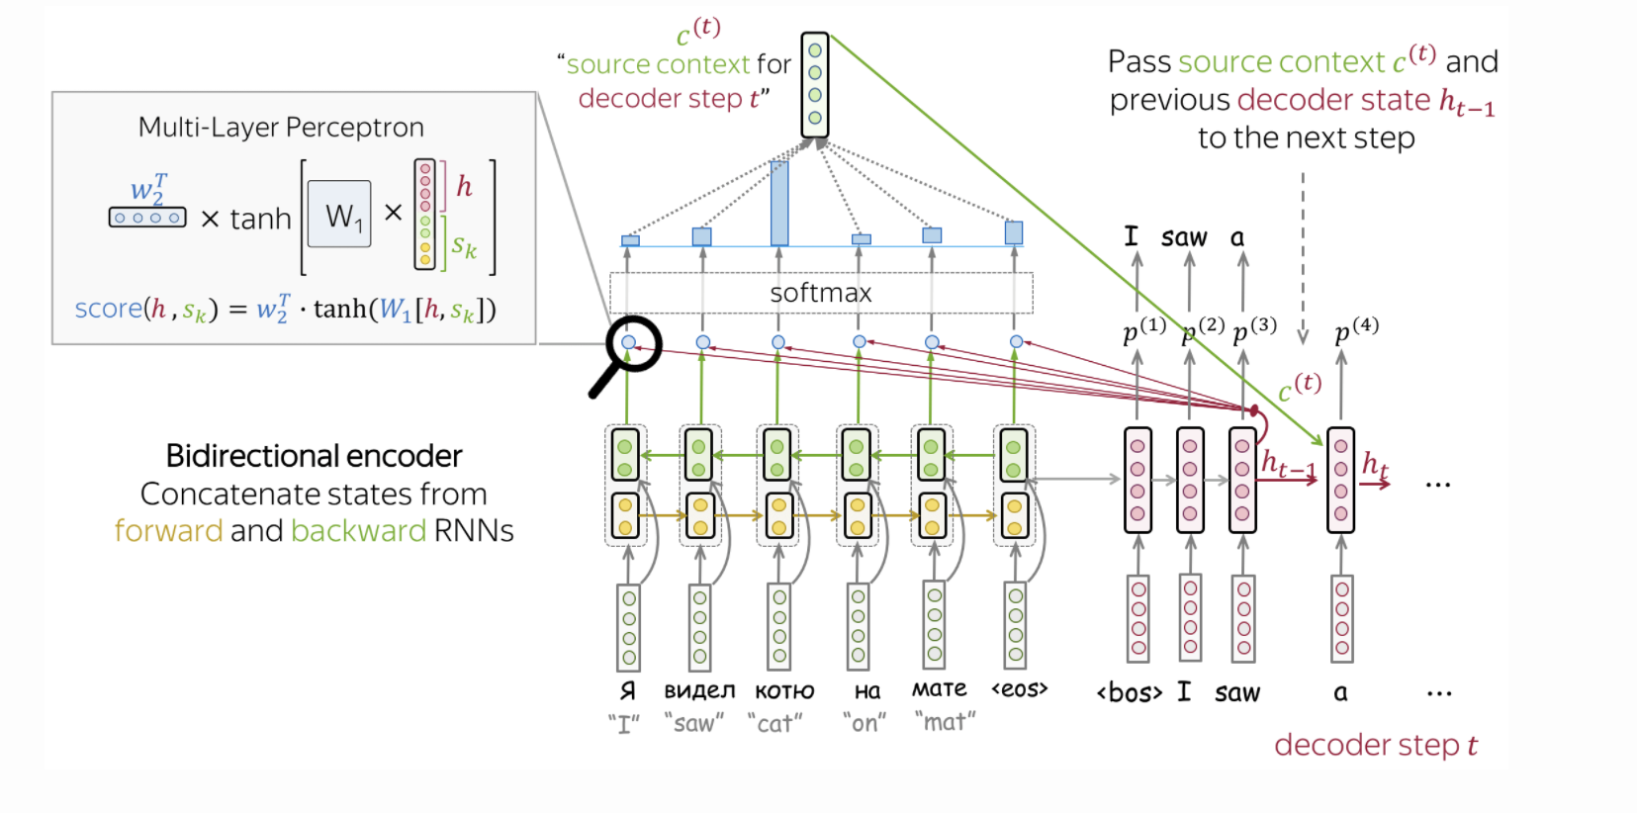
Bahdanau Model
Image source https://lena-voita.github.io/nlp_course/seq2seq_and_attention.html

Slide 34
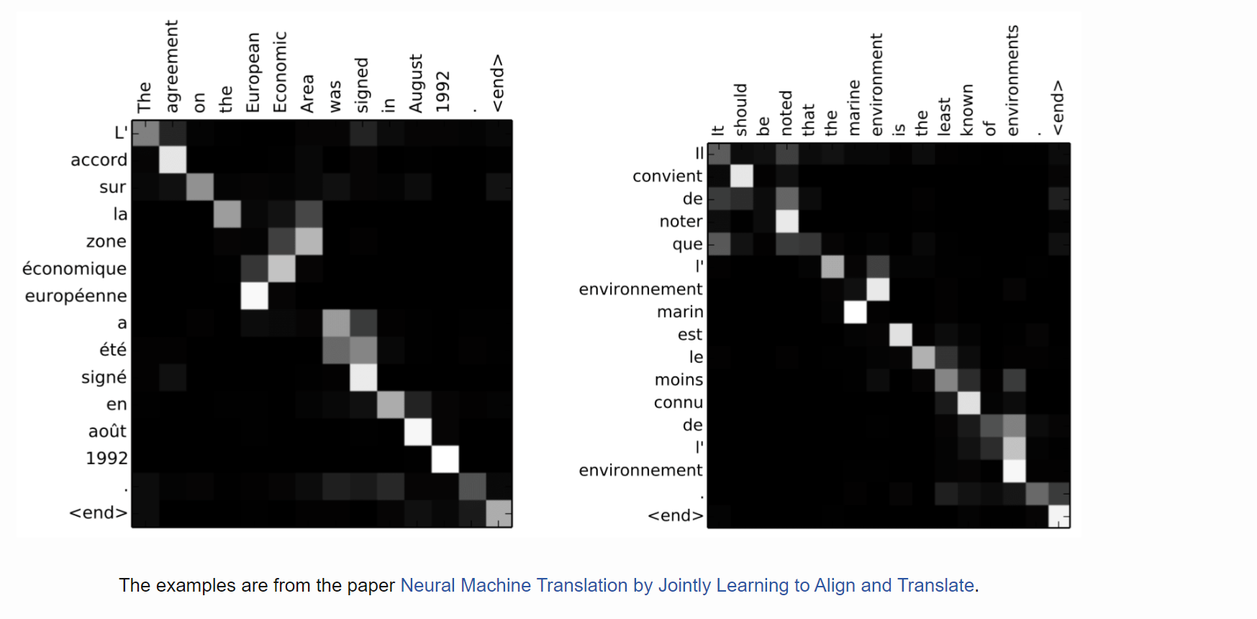
Attention Learns (Nearly) Alignment

Slide 35
Attention is great
Attention significantly improves NMT performance
It’s very useful to allow decoder to focus on certain parts of the source
Attention solves the bottleneck problem
Attention allows decoder to look directly at source; bypass bottleneck
Attention helps with vanishing gradient problem
Provides shortcut to faraway states
Attention provides some interpretability
By inspecting attention distribution, we can see what the decoder was focusing on
We get (soft) alignment for free!
This is cool because we never explicitly trained an alignment system
The network just learned alignment by itself
•
Slide Source : http://web.stanford.edu/class/cs224n/slides/cs224n-2020-lecture08-nmt.pdf

Slide 36
Attention general Deep Learning Technique
An attention layer explicitly select related information
Memory
Its memory consists of key-value pairs
The output will be close to the values whose keys are similar to the query
Values
Output
Attention
Keys
Query

Slide 37
Attention is a general Deep Learning technique
Given a set of vector values, and a vector query, attention is a technique to compute a weighted sum of the values, dependent on the query.
Intuition:
The weighted sum is a selective summary of the information contained in the values, where the query determines which values to focus on.
Attention is a way to obtain a fixed-size representation of an arbitrary set of representations (the values), dependent on some other representation (the query).
Slide Source : http://web.stanford.edu/class/cs224n/slides/cs224n-2020-lecture08-nmt.pdf

Slide 38
Contextual Embeddings

Slide 39
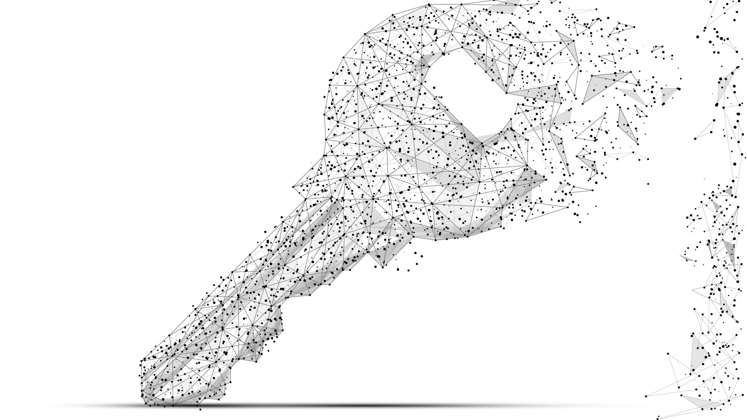
Context is key
Language is complex, and context can completely change the meaning of a word in a sentence.
Example:
I let the kids outside to play.
He had never acted in a more famous play before.
It wasn’t a play the coach would approve of.
Need a model which captures the different nuances of the meaning of words given the surrounding text

Slide 40
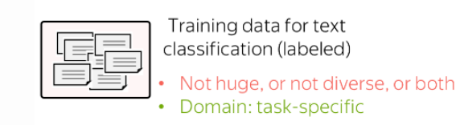
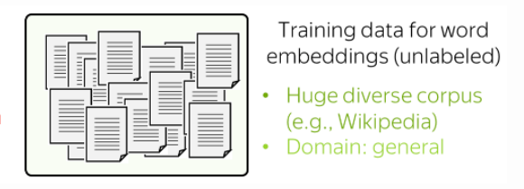
Pre-Trained Embeddings
Source: https://lena-voita.github.io/nlp_course/transfer_learning.html

Slide 41
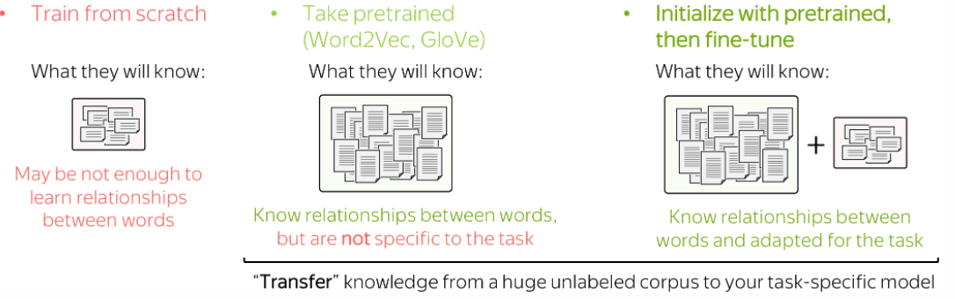
Pre-Trained Embeddings
Source: https://lena-voita.github.io/nlp_course/transfer_learning.html

Slide 42
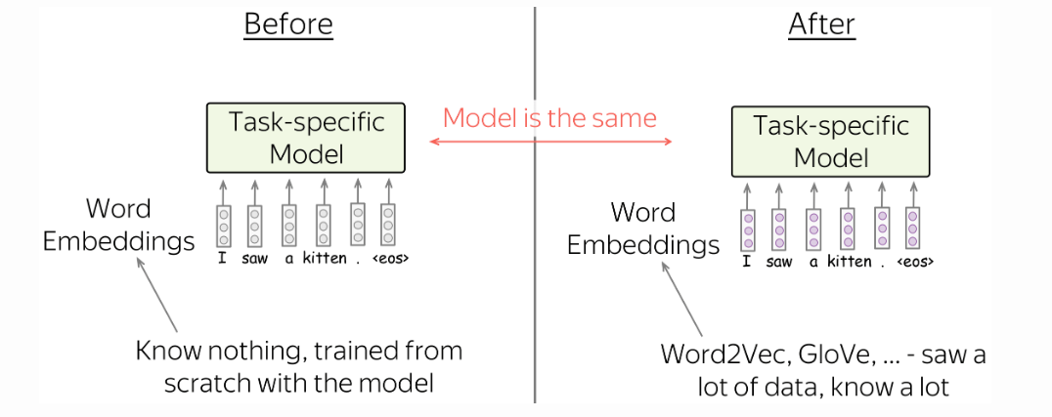
Pre-Trained Embeddings
Source: https://lena-voita.github.io/nlp_course/transfer_learning.html

Slide 43
Context is key
Previous models (GloVe, Word2Vec, etc.) only have one representation per word
They can’t capture these ambiguities.
We just have one representation for a word, but words have different aspects, including semantics, syntactic behavior, and register/connotations.
When you only have one representation, all levels of meaning are combined.
Solution: have multiple levels of understanding.
Embeddings from Language Model representations
Source: https://lena-voita.github.io/nlp_course/transfer_learning.html

Slide 44
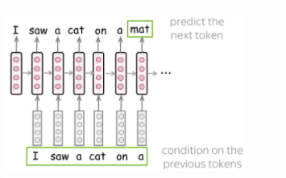
Language Model
Those RNN layers are trained to predict the next word
But those language models are producing context-specific word representations at each position – Can we use these as context specific embeddings?
Image source https://lena-voita.github.io/nlp_course/seq2seq_and_attention.htm

Slide 45
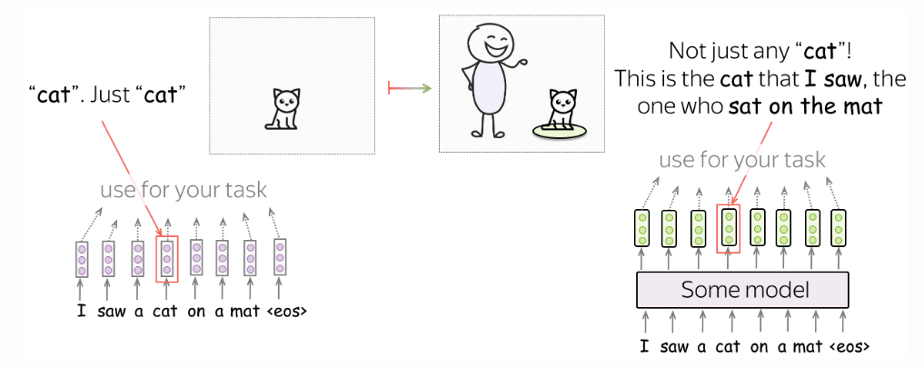
Language Model – Context Specific Embeddings
Image source https://lena-voita.github.io/nlp_course/seq2seq_and_attention.htm

Slide 46
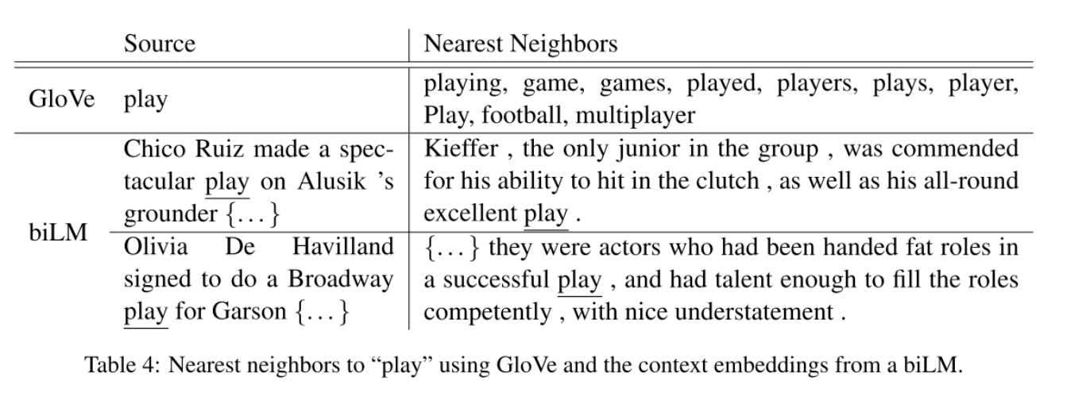
Contextualized word representation
From Peters et al. 2018 Deep contextualized word representations (ELMo paper)

Slide 47
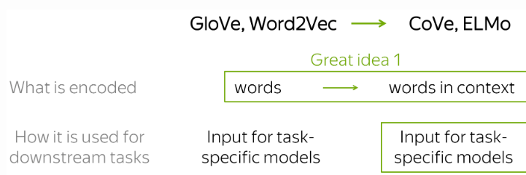
Embeddings from Language/Translation Models
Source: https://lena-voita.github.io/nlp_course/transfer_learning.html

Slide 48
Domain Adaptation

Slide 49
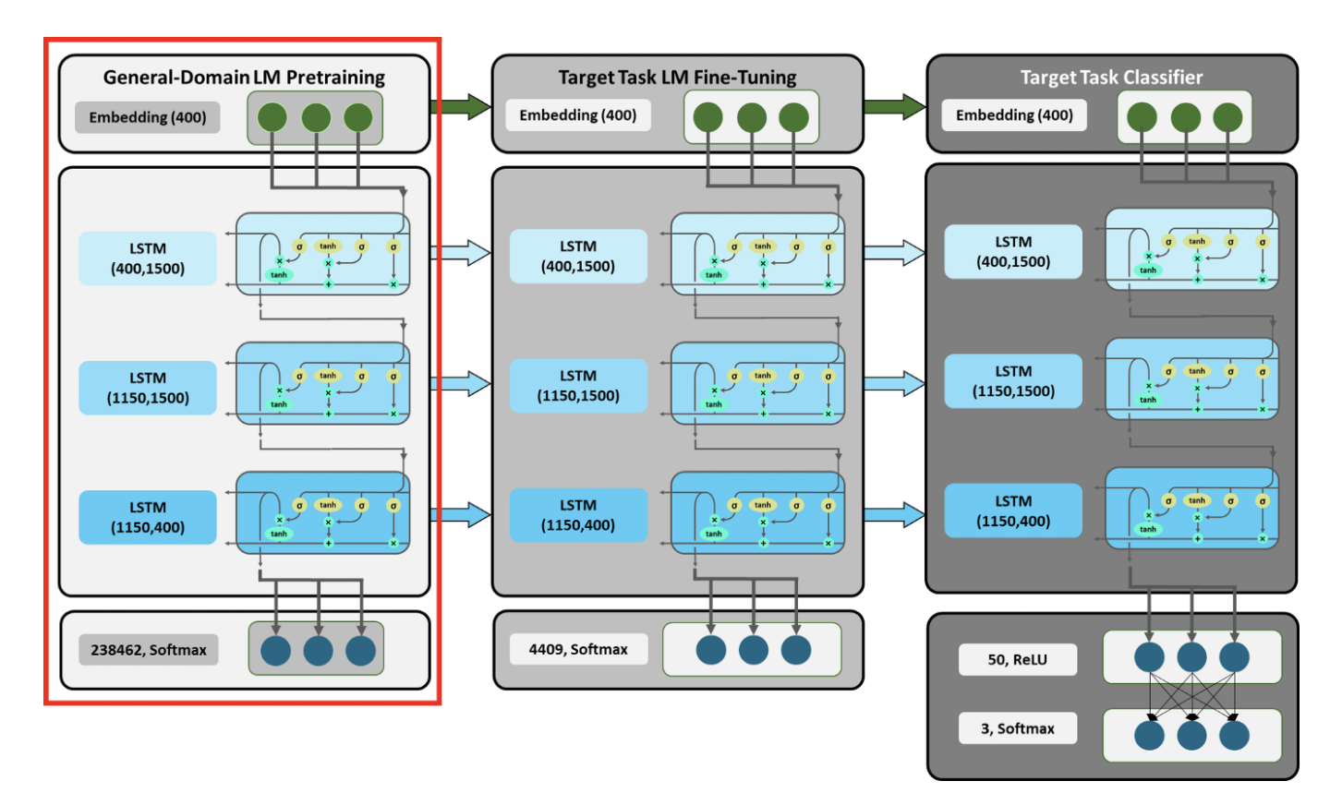
ULMfit
Train LM on big general domain corpus (use biLM)
Tune LM on target task data
Fine-tune as classifier on target task
Image source: https://towardsdatascience.com/understanding-ulmfit-and-elmo-the-shift-towards-transfer-learning-in-nlp-b5d8e2e3f664

Slide 50
ULMfit emphases
A lot of care in LM fine-tuning
Different per-layer learning rates
Slanted triangular learning rate (STLR) schedule
Gradual layer unfreezing and STLR when learning classifier
Image source: https://towardsdatascience.com/understanding-ulmfit-and-elmo-the-shift-towards-transfer-learning-in-nlp-b5d8e2e3f664

Slide 51
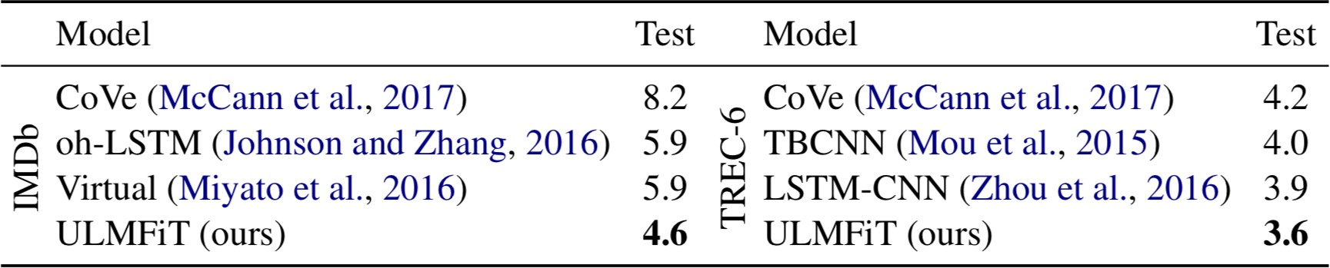
ULMfit performance

Slide 52
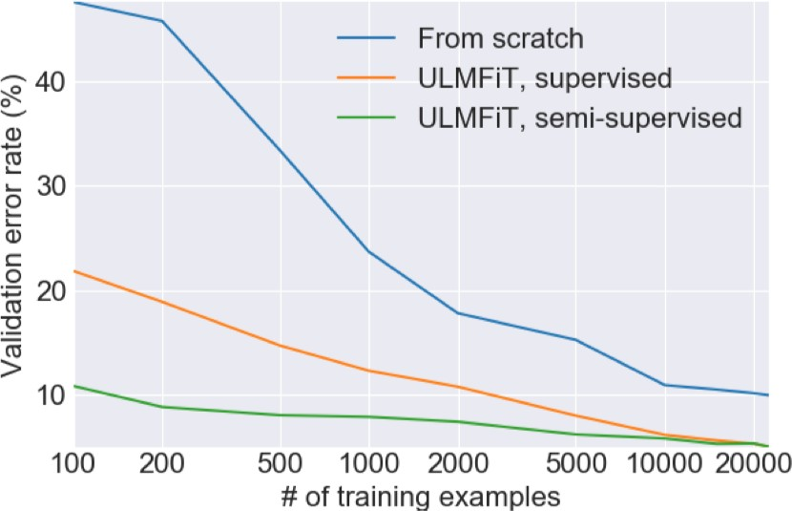
ULMfit transfer learning

